Slide 1



What’s It Really Going to Take?
Employment First
David Hoff
Institute for Community Inclusion
University of Massachusetts, Boston
National Board President
APSE

Slide 2

Contact Information
David Hoff
617-287-4308
david.hoff@umb.edu
www.communityinclusion.org
david@apse.org
www.apse.org

Slide 3

It’s A Time of Enormous Opportunity

Slide 4
Employment First – the concept that employment should be the first and primary service option for people with disabilities - continues to grow.
Employment First Movement now in 35+ States
24 States with an
Official Policy

Slide 5
National Governor’s Association Initiative

Slide 6
Senate HELP Committee Report
Increase employment of people with disabilities by
over 1 million by 2015

Slide 7
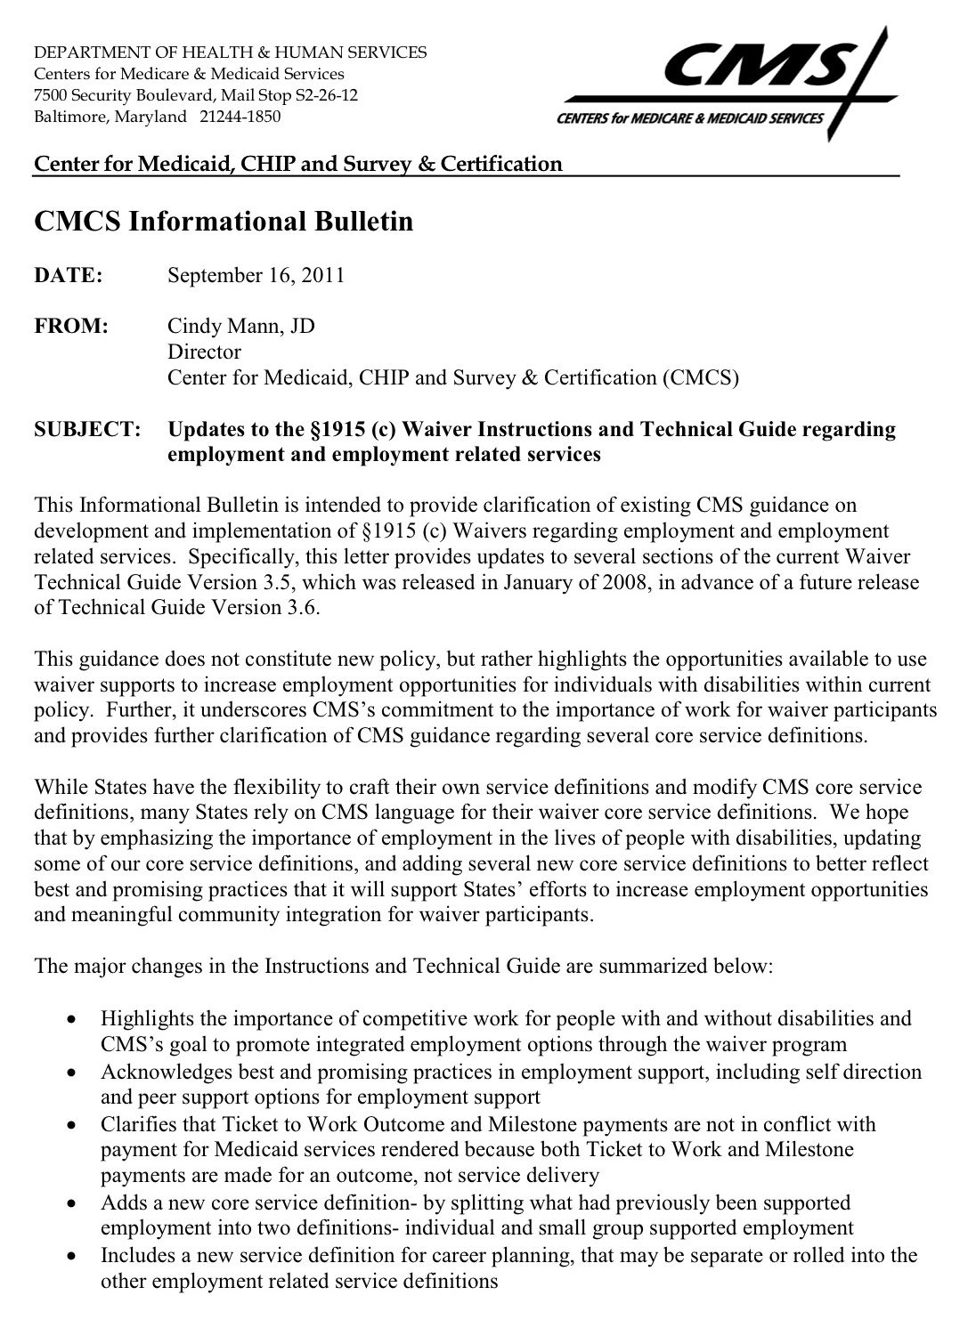
CMS Bulletin
Highlights and provides guidance for implementation of CMS’s goal to promote integrated employment options through Medicaid waiver program

Slide 8
Federal Hiring
Increased efforts by federal government to hire people with disabilities under “Schedule A”.
February 2013 rules eliminated need for certification of “job readiness”.

Slide 9

Expanded Health Care Options under the Affordable Care Act

Slide 10
National Council on Disability Report
Federal Agency calling for phase out sub-minimum wage as part of overall systems change
Make fundamental changes in transition

Slide 11

Oregon Lawsuit
Claims placement in sheltered workshop is violation of ADA
US Dept. of Justice is now a plaintiff in this suit

Slide 12


Requirements for expanding community employment increasingly part of settlement agreements with states

Slide 13

“A pessimist sees the difficulty in every opportunity.
An optimist sees the opportunity in every difficulty.”
Winston Churchill

Slide 14

Employment First:
What It Is and What It Isn’t

Slide 15
Employment First IS NOT
A type of service strategy.
Just promotion of best practices.
A clear public policy of employment as the first and preferred option for individuals receiving publicly funded services.
Policies, practices, and resource allocation that prioritize employment in the general workforce.
Employment First IS

Slide 16
Successful Employment Under Employment First
Employer paid
Fully integrated within the general workforce working side-by-side with co-workers without disabilities
Minimum wage or higher with a goal of a living wage
Employment based on an individual’s talent, skills, interests, preferences

Slide 17

“Any darn fool can make something complicated; it takes genius to achieve simplicity.”
- Woody Guthrie

Slide 18
The Magic Formula
People looking for work
Employers willing to hire
JOB!
Service System Supports as Necessary

Slide 19
What Employers are Saying
They value hiring employees with disabilities – but they have trouble finding qualified candidates with disabilities
Many don’t know where to recruit people with disabilities
Many don’t value or are even aware of service providers
Those that have worked with service providers have “mixed” feelings about the experience

Slide 20

Business View of Service Providers
Kessler Foundation/National Organization on Disability Survey - 2010
QUESTION: If you have used a service provider, how effective have they been in recruiting, hiring, and retaining people with disabilities?
Response Choices:
1. Extremely Effective
4%
2. Very Effective
14%
3. Effective
16%
4. Somewhat Effective
51%
5. Not Effective
11%
6. Unsure
4%

Slide 21
Quality of Job Candidates
13% of employers felt that service providers did not provide qualified candidates
1 out of 5 human resource managers surveyed felt this was an issue
Source: Kessler Foundation/NOD Disability Survey - 2010

Slide 22
What Employers Say They Want Help With
Finding qualified candidates
Expertise and assistance on job accommodations and assistive technology
Post-placement support, including job coaching
Matching job descriptions with skills of candidates

Slide 23


A Job Development Story
The Employer

Slide 24

Top 10 Biggest Job Development Mistakes
10. Focusing on a very narrow portion of the job market,
particularly “disability-friendly” jobs.
9. Marketing “disability” or “the program”
not individuals.
8. Not knowing the job seeker – and job seekers not
knowing themselves.
7. Job development that has no relation to
planning process.
6. Not using a strength-based approach.

Slide 25
Top 10 Job Development Mistakes
5. Not understanding and responding to
employer’s needs.
4. Not using personal & professional networks.
3. Reliance on employer-demand techniques.
2. Lack of knowledge & creativity regarding how to
enhance match between job seeker and employer.
1. “Leaving it to the professionals” - lack of involvement
by job seeker in job search.

Slide 26

Why is it that everything we know about a good job search for people without disabilities, we too often forget when it comes to a job seeker with a disability?

Slide 27

Do you know?
Who are the biggest employers in your area?
What employers do the most hiring?
Where are the largest number of job openings?
What skills and occupations are in the highest demand?

Slide 28
Expanding the Labor Market
Use LMI to understand the Labor Market - http://ohiolmi.com
Consider the full labor market when planning and conducting a job search
Don’t forget about public employment:
  Federal hiring initiatives (Schedule A)
  State and local government
Don’t forget about Federal Contractors
Labor

Slide 29


Labor Market Information shouldn’t drive the employment process.
But it should be part of the process.

Slide 30

Employers with previous experience with workers with disabilities have favorable perceptions and are more likely to hire.
Unger, D. – Virginia Commonwealth University, 2002

Slide 31


More Networking
Utilize current employers as a springboard
Find employers with personal connection to disability
Build social capital through community involvement
It’s everyone’s job
Less Cold Calling

Slide 32


What Job Development Is Not
Filling out job applications
Searching for jobs on the internet

Slide 33

John Wooden
"Never mistake activity for achievement."
Notes:
Job development is not filling out applications and internet job searches

Slide 34
“You can teach a turkey to climb a tree, but it’s easier to hire a squirrel.”
Spencer, McCleelan, Spencer - Competency Assessment Methods

Slide 35
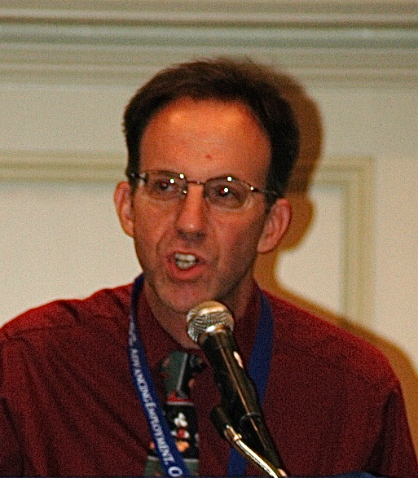
Avoid the employment readiness myth
Employers are expecting perfect employees

Slide 36
Have you ever worked with anyone who…
Couldn’t get along with others?
Acted inappropriately?
Had behavioral outbursts?
Was chronically late?
Complained about everything?
Didn’t communicate well?
Didn't work very fast?
Got distracted easily?

Slide 37
Have you ever worked with anyone who…
Didn’t take directions well…or at all?
Acted impulsively without thinking?
Had a messy office?
Wasn’t organized?
Wasn’t always professional?
Was rude?
Couldn’t take criticism?
Was lazy?
Wasn’t very good at their job – but managed
to still keep it?

Slide 38

“80% of success is
showing up."
- Woody Allen

Slide 39
Employer Needs
Filling the Gap
Skill
and Qualification Gap
Good job matching
Accommodations
Assistive technology
Quality job coaching
Short-term job tryouts/internships
Increasing job skills of job seeker through education
Job creation
Job carving
Business within a business
Others
Employer Needs
Job seeker skills & abilities
Job seeker skills & abilities

Slide 40

“The length of a minute is relative, depending on
which side of the bathroom door
you are on.”
Ken Miller
www.wedontmakewidegets.com

Slide 41

Job Development Time is Precious
Enough time
Using that time efficiently and effectively
CRITICAL NEED
Better understanding of what job development practices are….and are not effective in terms of
quantity and quality of outcomes
Notes:
SLOW
Example of TA with providers
We’re so glad someone is willing to do job development – but we need to care how they do it

Slide 42
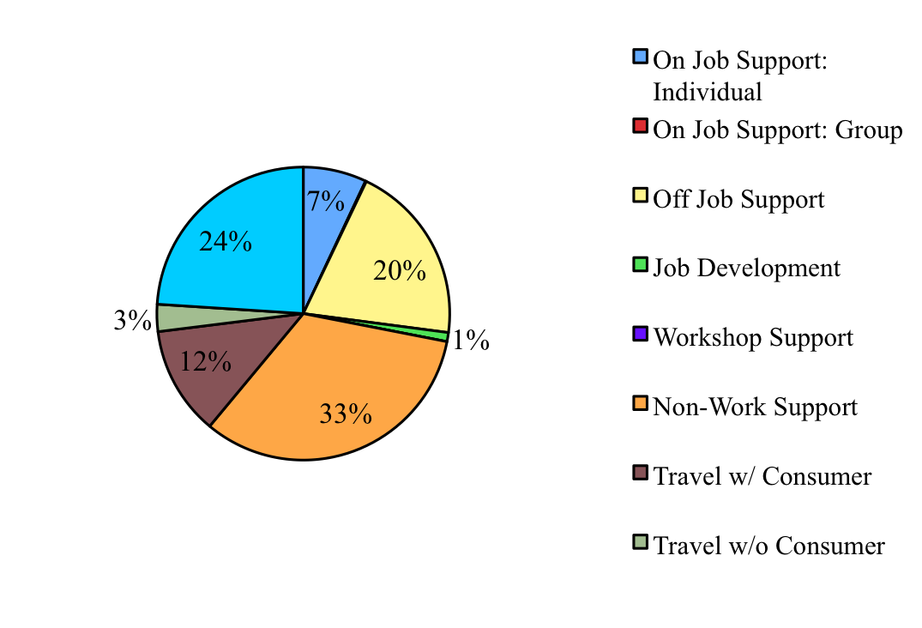
Example of Use of Direct Service Staff Time
By Service Provider

Slide 43

“We’re Far Too Patient With The Passage Of Time For People With Disabilities. . .
Time Is As Precious For A Person With A Disability
As It Is For All Of Us.”
- Gerry Provencal

Slide 44
More intensive intervention
Less intensive intervention
EMPLOYMENT STRATEGIES & TECHNIQUES
Full scale discovery Job creation Job carving Customized strategies Short-term job trials | Comprehensive person-centered planning Professional job development Job coaching More complex accommodations Job skill training | Assistance with job search plan Job search guidance & counseling Guidance on disability issues/disclosure Simple accommodations | Standard job search practices Resume assistance Help with job leads Brush up interview skills
More time & resources
Less time & resources

Slide 45

What will be the best route to employment success?
Situational Assessment
Person-Centered Planning
Job Creation
Job Development
Community Exploration
PASS
Employment Success
Benefits Planning
Find a Job
Pursue Job Leads
Develop Resume
Plan Job Search

Slide 46
Using Resources Well
Figure out which level and types of intervention will be most efficient and effective in achieving successful employment outcome.
Factors
Work experience
Job skills
Clarity about employment goals
Level of disability

Slide 47
Increased levels of intervention take
more time, more resources,
and can negatively impact integration and inclusion of individual on the job – but may be necessary.
Remember:
Deviating from typical employment processes has consequences,
so we should be careful and cautious
in doing so.

Slide 48
PROFESSIONAL SUPPORTS:
“WE ARE THE
LEAST BEST
ANSWER.”
- Jacqueline Rotteveel

Slide 49

Why Employment First is Important
Employment First
Sets a clear direction from a
policy and practice perspective

Slide 50

- George Santayana
“ Before the enormity of the Sphinx, they would stand and talk of the desert heart. ”

Slide 51
Employment First will only be successful if the vision of Employment First is integrated within the wide range of
POLICIES, PROCEDURES, & PROCESSES
that impact employment of people with disabilities.
Human resources: staff training, development, competency requirements
Funding & service contracting
Service system infrastructure, including support services
Transition
Data: collection & use
Others

Slide 52

SELN:
What We’ve Learned
Systems change requires both:
  big picture perspective and leadership
  willingness to get into “nitty gritty” policy and practice details
It’s not one thing, it’s a lot of things
Slow and steady wins the race
Notes:
SLOW
- Big picture – clear vision is important a la Employment First
- Any well run organization does a lot of things well

Slide 53

Turning Employment First Into Reality:
Polices & Practices that Presume Employability
Eliminate criteria and professional judgments regarding work “readiness” and earning right to a job
Consideration of employment mandated part of any type of individual planning for persons of working age (ISP, IEP, etc.)
Documentation for non-consideration of employment is required
Decision to not consider employment is re-visited on regular basis
  Follows tenants of person-centered planning –“nothing about me without me”

Slide 54
Ohio Employment First Form

Slide 55


Employment First & Transition Policies
Prohibit use of facility-based services during transition
Allow facility-based services as outcome as exception requiring high administrative approval
Employment addressed as a core element of IEP starting no later than age 14
Require high level of documentation if decision is made not to pursue employment
Effective outcome measurement and monitoring

Slide 56



Employment First & Transition Practices
Presume that all students can succeed in employment
Support typical student work experiences
  Jobs after school and weekends; summer jobs
  No more job “programs”
Integrate students into school-to-career opportunities available to all students
  Internships, job shadowing, etc.
Link with vocational education programs

Slide 57

Employment First:
Contracting & Program Monitoring
Service provider contracts awarded to organizations that embrace Employment First principles.
Reduced reliance on contractors that reinforce traditional service approaches.
Service contracts clearly specify expectations regarding service provision and outcomes in line with Employment First principles.
Standards for employment in the community integrated within program monitoring and quality assurance processes.

Slide 58

“When somebody say it’s not about the money, it’s about the money.”
H.L. Mencken

Slide 59

- Pay for what you want.
- Don’t pay for what you don’t want.
Determine current breakdown of funding: community employment, facility, non-employment
Develop rate structures that provide incentives for employment
Develop funding policies that support shifting of resources to community employment

Slide 60

“If you can’t
measure it,
I’m not interested.”
Laurence J. Peter

Slide 61


Making System Accountable
Data system in place that tracks outcomes: providers, system, across systems
Publicly available employment
“report card”
  System and individual provider

Slide 62
A Challenge to
Our Field
Anecdotes and gut instincts are not enough
We need to be much more data driven in our decision-making in terms of
  services to individuals
  service provider operations
  system operations
We as a field need a stronger basis of research regarding effective practices and benchmarks.

Slide 63

“Culture
eats strategy
for breakfast.”
Peter Drucker

Slide 64
To make Employment First a reality requires a fundamental cultural change among:
Policymakers
Service systems & funding agencies
Service providers & staff
Employers and businesses
People with disabilities and families

Slide 65





You’re better off
not working.
Social Security told me I can’t work.
There are
no jobs.
You’re not job ready.
“I think you should go to work.”
You’ll
lose your health care!

Slide 66
Examples of What A Real Culture Shift Means
All people with disabilities are viewed as capable of being successfully employed and earning a competitive wage.
No more asking “Do you want to work?” but instead “Where do you want to work?”.
Choosing not to work is no longer considered okay.
No more “preserve benefits at all costs” mentality.
Services: not “caretaking”, but investment in people, empowering them and facilitating full community inclusion.
People with disabilities working is the norm, not the exception.

Slide 67
How a Culture Shift Happens
IT STARTS WITH US
Peer-to-peer: individual to individual, family to family, business to business
One individual, one family, one employer, one policymaker, one politician, one community member at a time
Remember: Actions speak louder than words

Slide 68
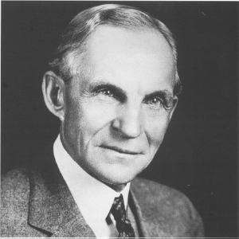
- Henry Ford
“If I had asked people what they wanted,
they would have said
a faster horse.”

Slide 69

The answer is out there, and it's looking for you, and it will find you if you want it to.

Slide 70
“Those who say it can't be done should get out of the way of those who are doing it.”

Slide 71

“It is nearly impossible to make your own future,
when you are not part of the economic fabric
of the culture you live in.”
- Patricia Deegan

Slide 72

“ A ship in harbor is safe --- but that is not what ships are built for. ”
John A. Shedd
Notes:
72

Slide 73

“ The bottom line of the social sector is changed lives”.
- Peter Drucker

Slide 74
Thanks!

